Slide 1

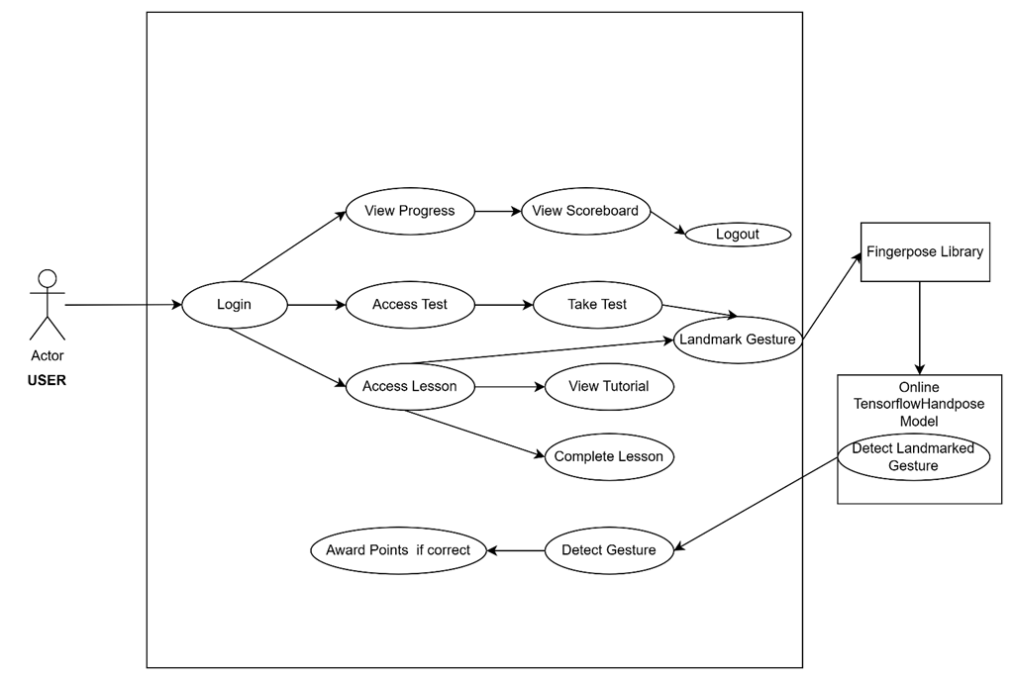
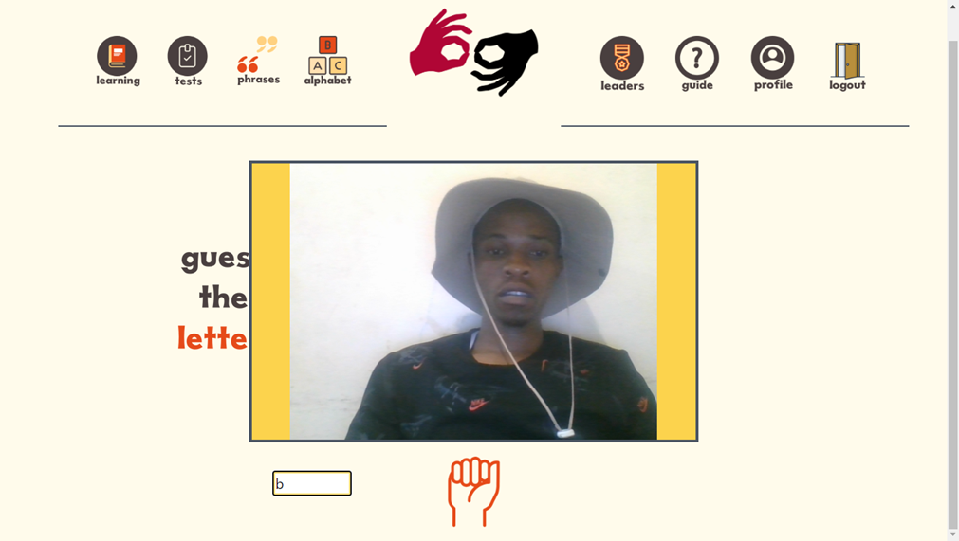
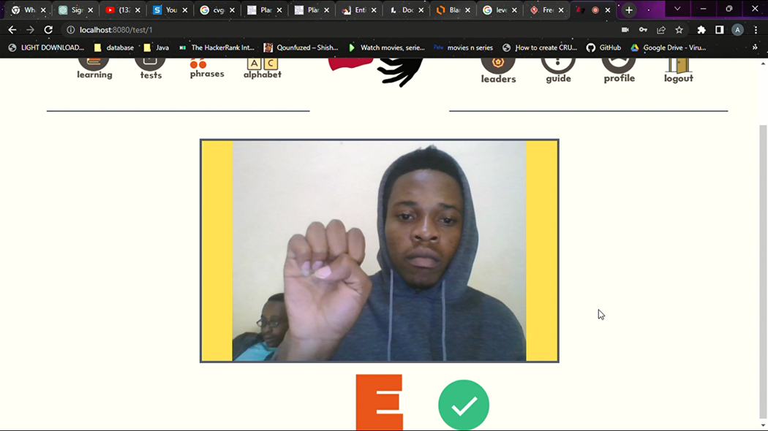
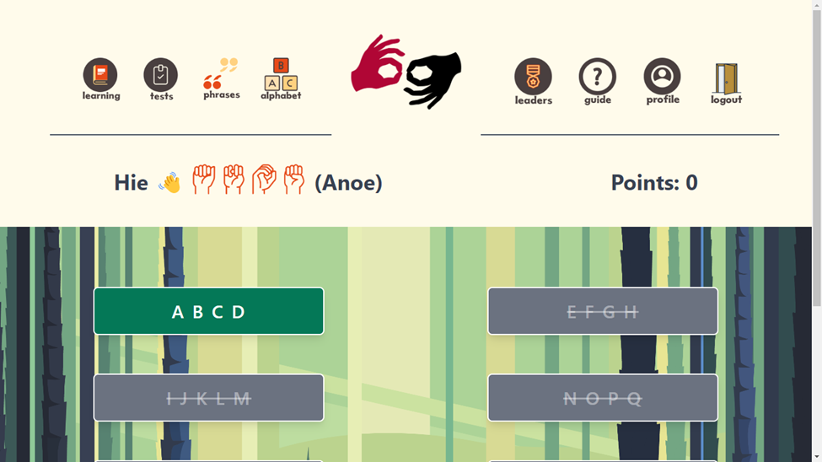
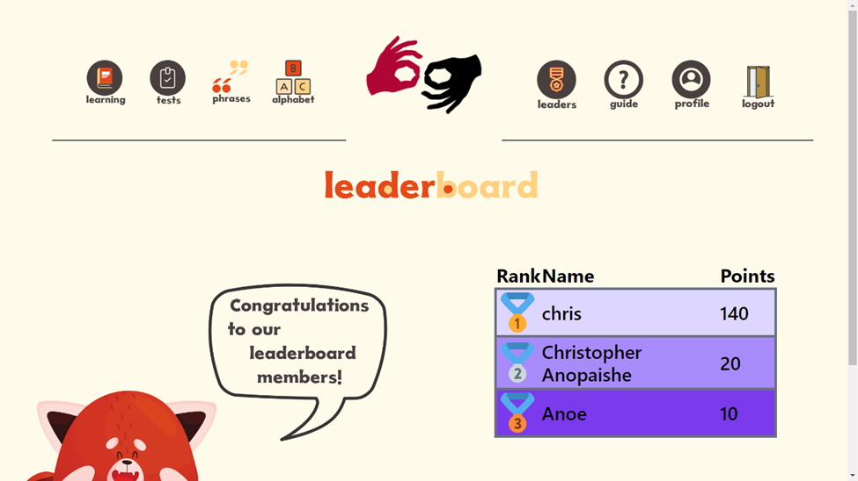
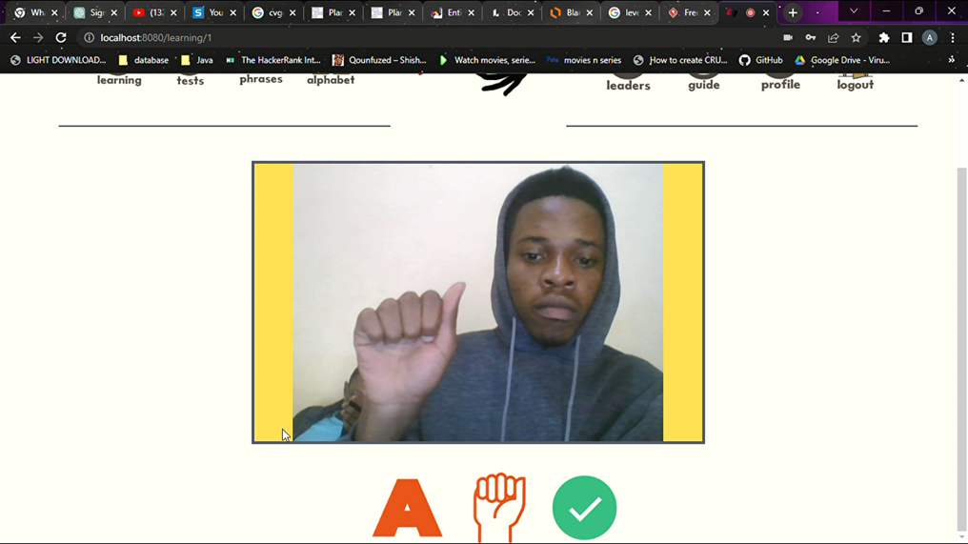
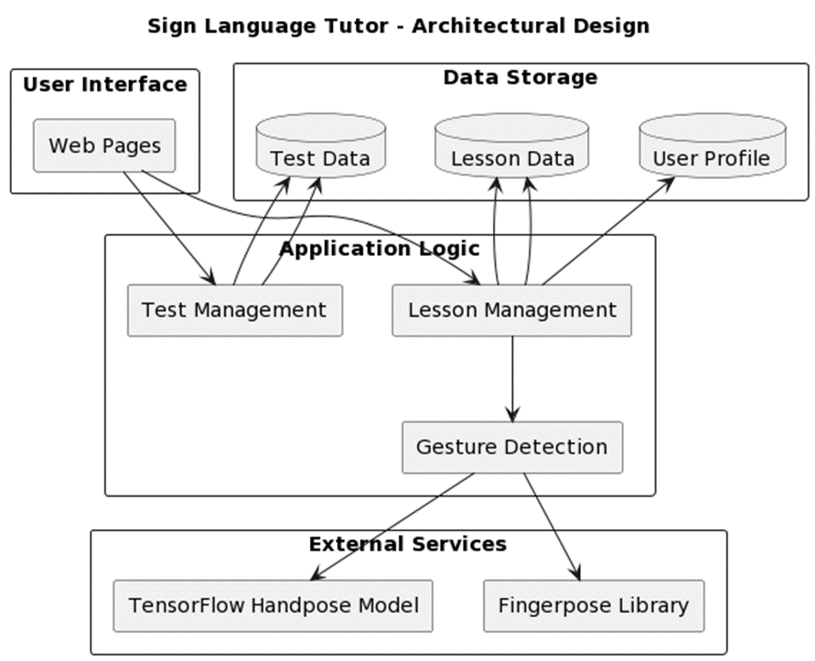
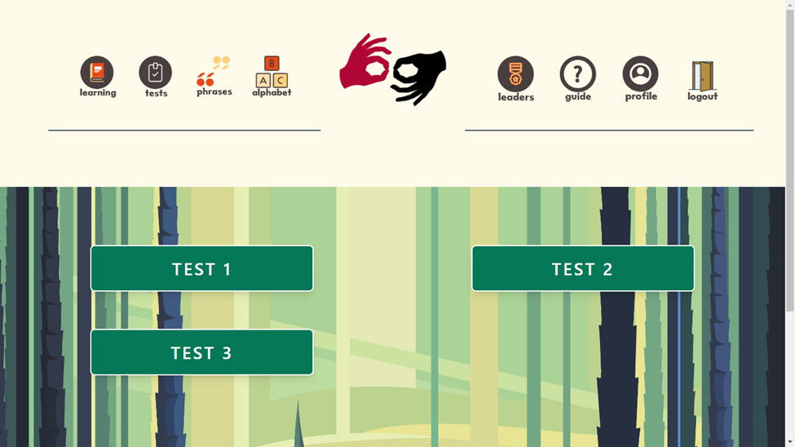
SIGN LANGUAGE TUTOR
Christopher Anopaishe Meki- Software Engineering Department
1.0 Abstract
comprehensive learning materials. This results in limited opportunities for practice, slow progress, and difficulties in acquiring fluency in sign language thus lack of portable, on-the-go and cheap methods to facilitate sign language learning hence difficulty in communication amongst the deaf, hearing impaired and normal hearing people. There is need to develop a web based e-tutor (Sign Language Tutor) to facilitate interactive sign language learning.
7.0. Use Case Diagram
The sign language tutor application is a software program designed to teach users sign language using an interactive and engaging platform. The app is designed to be accessible to all individuals who are interested in learning sign language, regardless of their proficiency level. The app includes a range of sign language courses, from beginner to advanced levels, that are presented through interactive quizzes and test for the sign alphabet (ASL) and gifs for common words.
The app's user interface is designed to be intuitive and easy to navigate. Users can choose the lesson they want to take and access them through the app's dashboard. Each lesson is broken down into segments that cover different aspects of sign language alphabet. The lessons are designed to be engaging and interactive, with images that show how to perform different signs and quizzes that test the user's knowledge.
The app also includes a range of features that help users track their progress and stay motivated. These include progress tracking and gamification. Progress tracking enables users to see how far they have progressed in their courses, while gamification incentivizes learning by having a scoreboard with scores show how the user is faring against other users.
4.0. Overview of the developed application
The system's user interface is intuitive and easy to navigate, enabling users to access lessons and tests/quizzes easily. The courses are presented through sign image recognition tutorials/lessons, interactive quizzes, and gifs for common words, making the learning process engaging and effective. The lessons show how to perform different signs, and the quizzes test the user's knowledge, providing feedback through points scored.
The system also includes features that help users track their progress and stay motivated. These include progress tracking and gamification. Progress tracking enables users to see how far they have progressed in their courses, while gamification incentivizes learning while gamification incentivizes learning by having a scoreboard with scores which show how the user is faring against other users and also new lessons and test are unlocked after passing previous lessons.
8.0. Screenshots
2.0. Introduction
5.0. Objectives
Communication is a fundamental aspect of human interaction, enabling the exchange of ideas, emotions, and information. However, individuals with hearing disabilities face significant challenges in effectively communicating with others. Sign language serves as a vital means of communication for the deaf and hard-of-hearing community, but learning and understanding sign language can be a complex and time-consuming process.
To address this issue, we propose the development of a Sign Language Tutor application. This application aims to leverage cutting-edge technologies, such as the fingerpose library and TensorFlow handpose model, to provide an interactive and effective platform for learning and practicing sign language gestures.
The Sign Language Tutor application will revolutionize the way people learn sign language by offering real-time recognition and interpretation of sign language gestures. It will empower users to communicate more confidently and efficiently, promoting inclusivity and breaking down communication barriers between individuals with hearing impairments and the broader community.
To identify sign letters accurately and provide sign language learning with the use of virtual sign interpreter using fingerpose library and TensorFlow handpose model.
To provide a mobile (on-the-go) method of sign language learning through the development of a web application
To provide unique education for people for easy, handy and very convenient learning on different sign languages by implementing interactive quiz assessments to complement the learning process
Conclusion
6.0. System Overview
The Sign Language Tutor application project has been successfully implemented, and it has proven to be effective in recognizing and interpreting sign language gestures using the fingerpose library and TensorFlow handpose model. The application provides users with an interactive platform to learn sign language easily and conveniently, with features such as sign gesture recognition, meaning interpretation, and a scoreboard to track progress. The implementation and testing of the Sign Language Tutor application have resulted in a robust and reliable application that can serve as a valuable resource for individuals interested in learning sign language. The application has the potential to make a positive impact on the lives of people with hearing disabilities, as well as those who want to communicate effectively with them.
Overall, the Sign Language Tutor application project has been a success, and it is poised to be an essential tool for promoting inclusivity and improving communication between people with hearing disabilities and the rest of the world.
3.0. Problem definition
Individuals with hearing disabilities face significant challenges in effective communication due to the lack of accessibility and interactive learning resources for sign language. Traditional methods of learning sign language, such as in-person classes or instructional videos, often lack interactivity, real-time feedback, and
Supervisor – Y Chibaya

